Slide 1




Updated spruce budworm damage maps for Ontario
Clara Risk, Patrick MA James
University of Toronto
Stephen Mayor
MNDMNRF

Slide 2
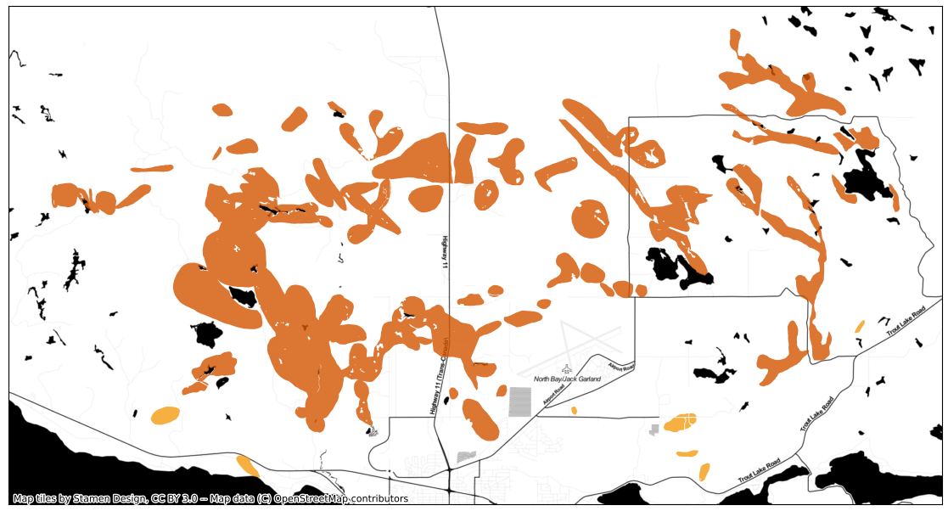
What is the problem with Ontario’s spruce budworm aerial survey data?

Slide 3
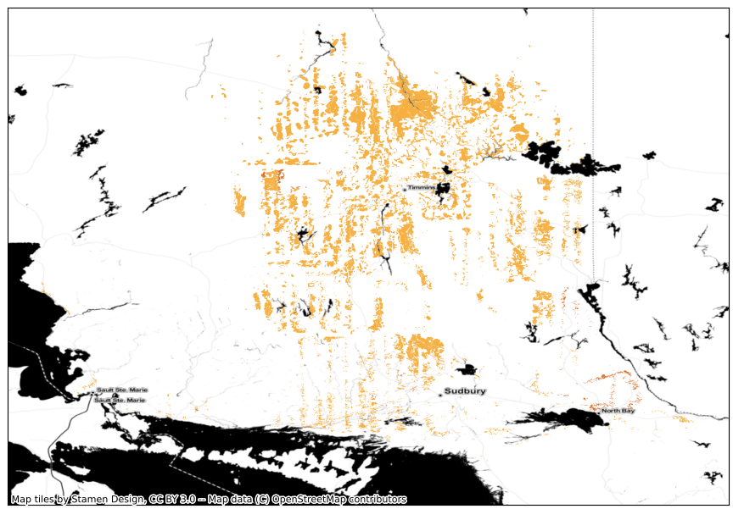
Let’s zoom out a bit:

Slide 4
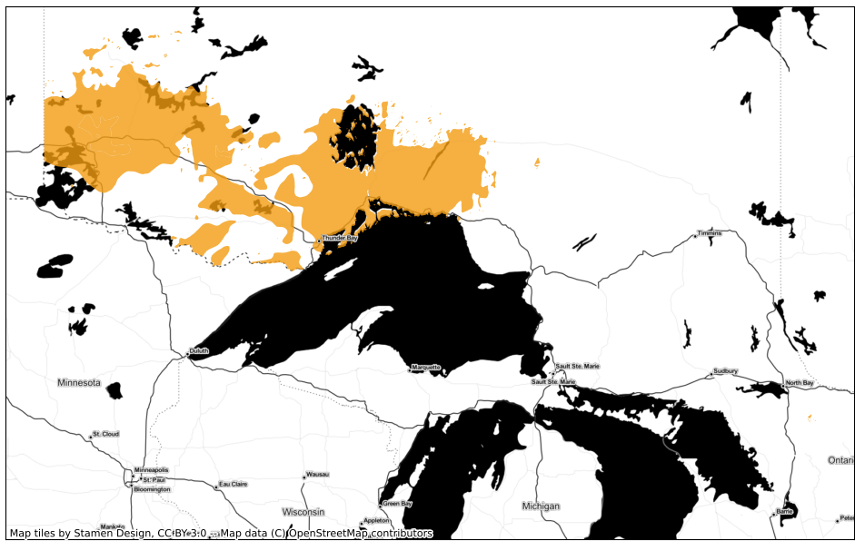
It’s not straightforward

Slide 5
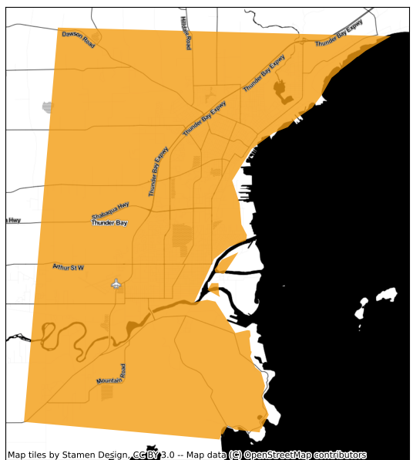
What’s the problem here? Let’s zoom in:

Slide 6
Can we use satellite imagery to estimate the true extent of current and historical spruce budworm damage?

Slide 7



Methods Walk-Through
Train a machine learning model using the 2021 aerial survey data
1
Sample damaged pixels from within the surveyed area and sample unaffected pixels from outside an 8 km buffer
2
Classify all pixels as either experiencing damage or not
3
Filter “noise” using a concave hull procedure
4
Provide certainty in the dataset by selecting “patches” of damage greater than 3 km²
5

Slide 8
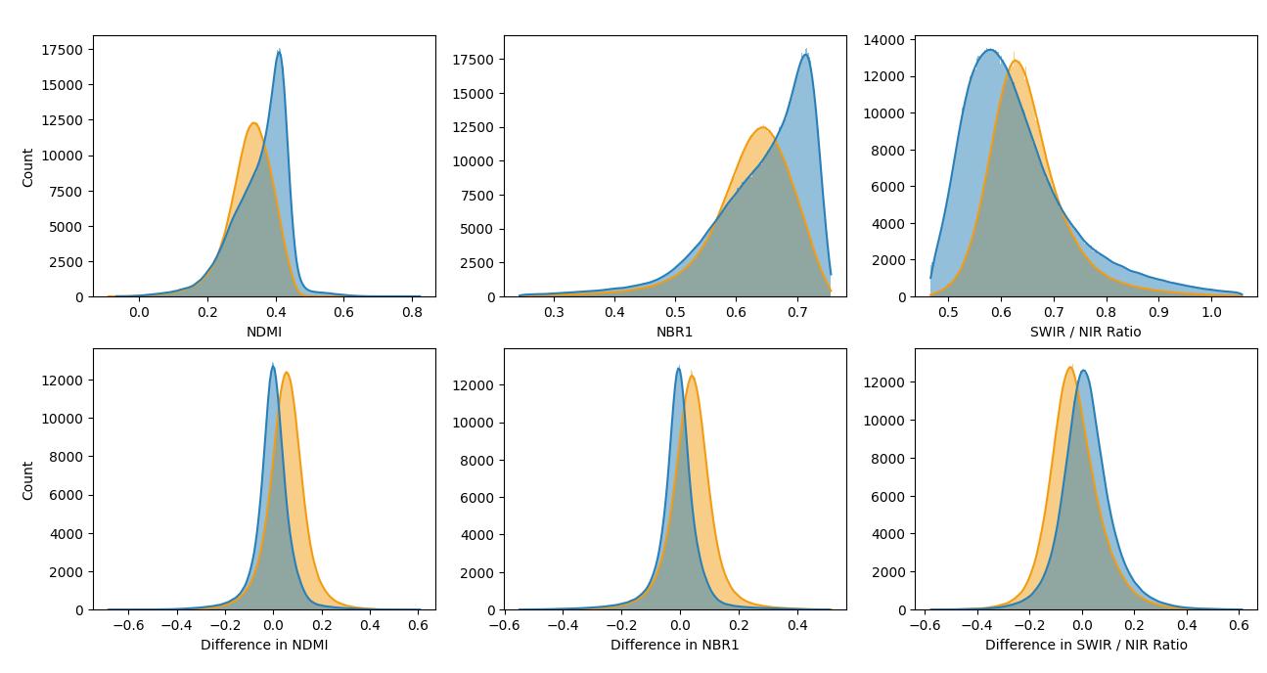
Why do we think we can do this?
Spectral indices are mathematical combinations of satellite image bands (ranges of wavelengths detected by the onboard sensor)
Unaffected
Affected

Slide 9
Why machine learning?
Helps us detect patterns that aren’t obvious to a human
A human can look at those distributions and tell you the range of spectral index values where a pixel is more likely to be affected
A human can’t easily determine the interactions between the spectral indices that could help us detect affected pixels
Random Forest models build complex decision trees to determine whether or not a pixel is likely to be affected

Slide 10
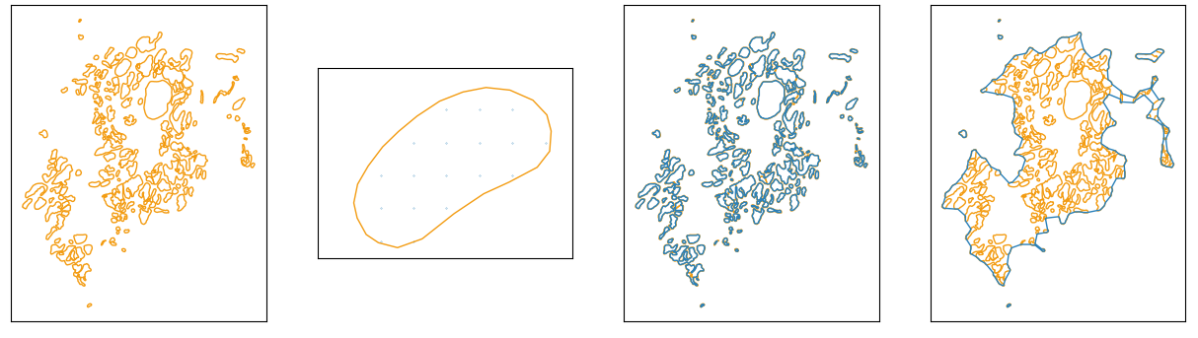
Why do we need the concave hull operation?
You’ll have noticed that the distributions overlap quite a bit
The concave hull operation is for where they overlap
Spruce budworm outbreaks tend to occur in “patches” close together
Concave hull operation helps us detect these patches

Slide 11
Why these methods?
Spectral Indices:
Multiple indices improve damage detection over single index (Rahimzadeh-Bajgiran et al., 2018; Rullan-Silva et al., 2013)
Selected based on investigations and past research (Dorion, 2016; Rahimzadeh-Bajgiran et al., 2018)
Difference between Healthy and Affected Years:
Essential for detecting spruce budworm damage, per past research
Random Forest Model:
Effective in detecting spruce budworm damage, per multiple studies (Bhattarai et al., 2020; Donovan et al., 2021; Rahimzadeh-Bajgiran et al., 2018)
Concave Hull Procedure:
Accounts for spatial autocorrelation in outbreaks, without using latitude/longitude (avoids banding on map)
Improves accuracy by considering surrounding pixels (Tobler's First Law of Geography)

Slide 12
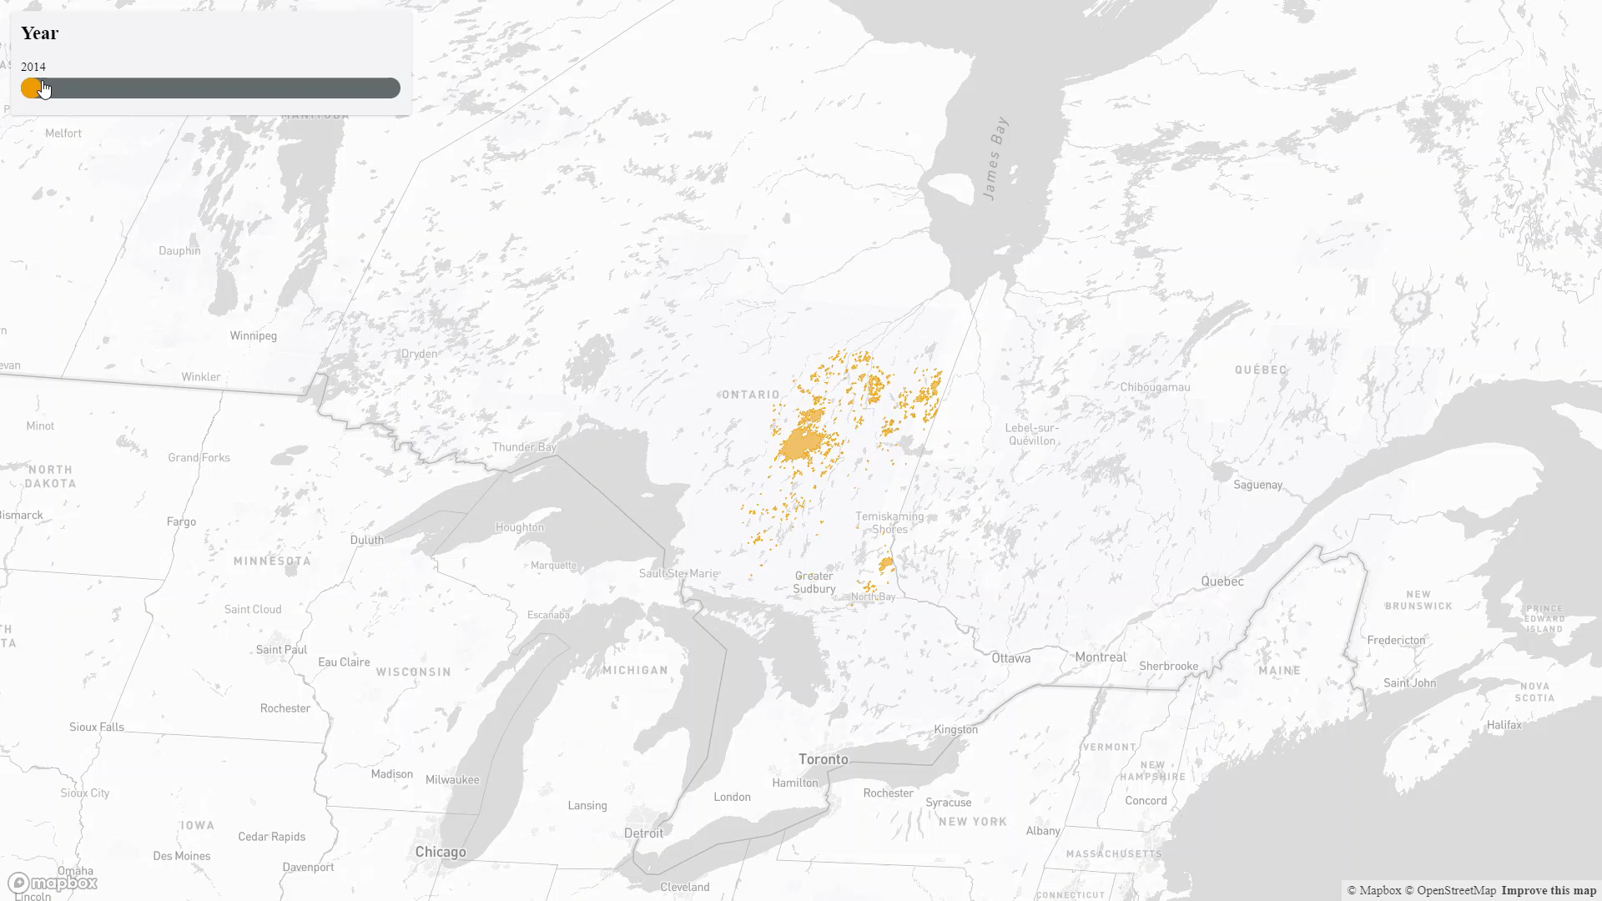
Maps for 2014-2021

Slide 13
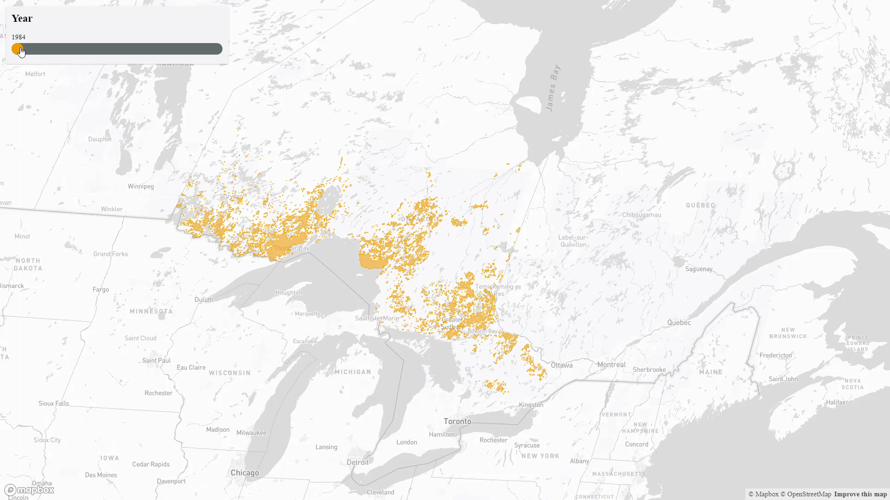
Maps for 1984-1997

Slide 14
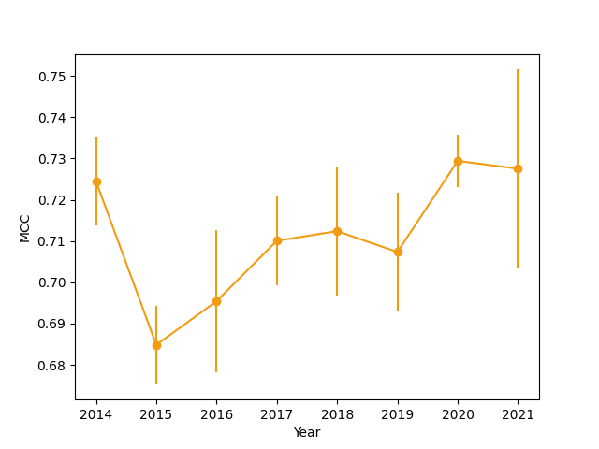
How accurate are these maps?
We used the Matthew’s Correlation Coefficient (MCC) to assess the accuracy of the model over time
It ranges between -1 to 1, with 1 being a perfect classification and 0 being a random one
MCC is generally accepted as industry standard in assessing machine learning models

Slide 15
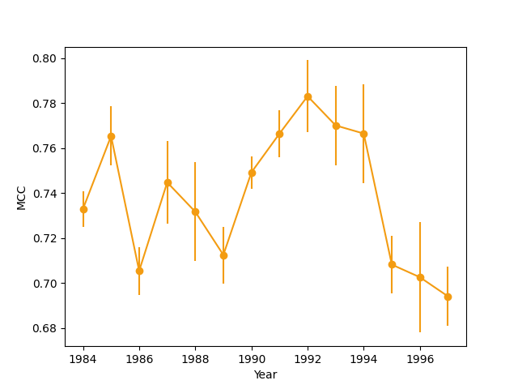
How accurate are these maps?
We used the Matthew’s Correlation Coefficient (MCC) to assess the performance of the model over time
It ranges between -1 to 1, with 1 being a perfect classification and 0 being a random one
MCC is generally accepted as industry standard in assessing machine learning models

Slide 16
How can this dataset benefit you?
Save fieldwork teams time and money
Targeted Btk application
Allow private landowners to assess risk to property and make informed decisions
Provide a standardized dataset to government research scientists
When should you use it?
Field work in Ontario related to forest succession or spruce budworm damage assessment – allow your teams to access sites closer to roads
Decision to protect your property using biopesticides
You need to avoid spatial bias in your ecological model

Slide 17
How will we be using it?
We will be using these maps quantify relative risk at the forest stand level across Ontario for different natural hazards, including spruce budworm damage and fire ignition
The resulting maps of relative risk will be informative for housing market research (particularly in cottage country), insurance purposes, and natural hazard prevention schemes

Slide 18
What about the aerial sketch maps?
They remain an excellent dataset and are indispensable to this work
We require the aerial survey maps to assess the performance of our method over time
What our method does is provide a “backup plan” – if weather conditions or smoke from wildfires obstruct technician field-of-view on the day of the survey, we can fill in the resulting gaps in the maps

Slide 19
Acknowledgements & Funding
Many thanks to the Government of Ontario for funding this work
This work was made possible by the Ministry of Northern Development, Mines, Natural Resources & Forestry, which provided data for this project

Slide 20


View through time:
1984 – 1997
2014 – 2021

Slide 21
References
Rahimzadeh-Bajgiran, P., Weiskittel, A. R., Kneeshaw, D., & MacLean, D. A. (2018). Detection of annual spruce budworm defoliation and severity classification using Landsat imagery. Forests, 9(6), 1-17. https://doi.org/10.3390/f9060357
Rullan-Silva, C. D., Olthoff, A. E., Delgado de la Mata, J. A., & Pajares-Alonso, J. A. (2013). Remote monitoring of forest insect defoliation. A review. Forest Systems, 22(3), 377-391. https://doi.org/10.5424/fs/2013223-04417
Dorion, H. (2016). Patrons spatiaux d ’ une épidémie de la tordeuse des bourgeons de l ’ épinette sur la Côte-Nord : une approche de télédétection. In (pp. 37).
Bhattarai, R., Rahimzadeh-Bajgiran, P., Weiskittel, A., & MacLean, D. A. (2020). Sentinel-2 based prediction of spruce budworm defoliation using red-edge spectral vegetation indices. Remote Sensing Letters, 11(8), 777-786. https://doi.org/10.1080/2150704X.2020.1767824
Donovan, S. D., MacLean, D. A., Zhang, Y., Lavigne, M. B., & Kershaw, J. A. (2021). Evaluating annual spruce budworm defoliation using change detection of vegetation indices calculated from satellite hyperspectral imagery. Remote Sensing of Environment, 253. https://doi.org/10.1016/j.rse.2020.112204

